Slide 2

Learning objectives
In this lesson you will learn to:
  define what is meant by the term 'character set'
  describe how characters are represented in 7-bit ASCII
  derive the ASCII code for one character when given the code for another
  outline the shortcomings of ASCII and understand how encoding systems that use more bits overcome them.
For more information about this topic and additional student activities see Topic 2 of the student book.
© Pearson Education Ltd 2020. Copying permitted for purchasing institution only.
Notes:
Specification content: 2.1.1 2.2.1 2.2.4

Slide 3
How computers store data
You have previously learned that computers represent all kinds of information in binary.
You have also learned that binary can be encoded in different ways to represent different kinds of information.
What types of information can you currently represent?
Unsigned integers Signed integers
Another kind of information that computers need to store is text.
© Pearson Education Ltd 2020. Copying permitted for purchasing institution only.

Slide 4
ASCII
One way to encode binary to store text is to use ASCII.
ASCII is the American Standard Code for Information Interchange.
It was created in the 1960s as a standard way to encode text on early computers.
© Pearson Education Ltd 2020. Copying permitted for purchasing institution only.

Slide 5
The ASCII code
ASCII (American Standard Code for Information Interchange) has become the standard code, used worldwide
It was originally developed in the 1960s for representing the English alphabet
It encodes 128 characters into 7-bit binary codes
Characters include numbers 0 to 9, uppercase and lowercase letters A-Z, a-z, punctuation symbols and a space character

Slide 6
Why is it necessary?
Imagine if everyone used a different encoding scheme for text.
If one group used the encoding on the right, and another group the encoding on the left, then they would not be able to communicate.
ASCII enables computing devices to communicate with one another and to translate their communication into identical information.
A |  | A
1101 1000 |  | 1000 1000
© Pearson Education Ltd 2020. Copying permitted for purchasing institution only.
Notes:
Student Activities 1 and 2

Slide 7
Bit patterns
You previously learned how to calculate the number of unique characters that can be represented using a set number of bits.
ASCII uses 7 bits.
How many values can you represent with 7 bits?
Can you remember how to calculate that?
Number of patterns = 2^{n}, where n is the number of bits.
ASCII patterns = 2⁷ = 128
© Pearson Education Ltd 2020. Copying permitted for purchasing institution only.

Slide 8
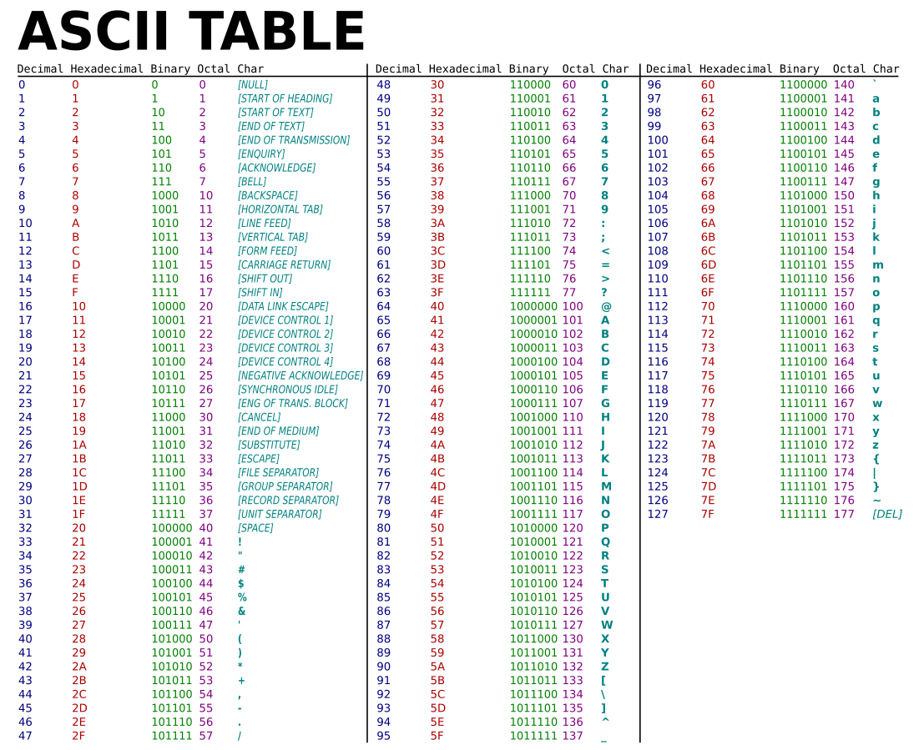
ASCII lookup table
This is an ASCII lookup table.
It shows the numbers associated with each character in the ASCII character set.
A character set is a list of the characters that a computer is able to translate.
© Pearson Education Ltd 2020. Copying permitted for purchasing institution only.
Notes:
Student Activity 1

Slide 9
Patterns
Whilst you are not expected to memorise the ASCII table, there are a couple of patterns that will help you to generate the codes.
The capital letter alphabet starts at denary 65 and the lower case alphabet starts at denary 97.
‘A’ is 65 in denary and is 0100 0001 in binary.
‘a’ is 97 in denary and is 0110 0001 in binary.
The upper and lower case alphabets have matching binary patterns.
© Pearson Education Ltd 2020. Copying permitted for purchasing institution only.

Slide 10
Finding patterns
Character | Denary | Binary
A | 65 | 0100 0001
a | 97 | 0110 0001
What do you add to the code for ‘A’ to find the code for ‘a’?
What do you subtract from the code for ‘g’ to find the code for ‘G’?
Character | Denary | Binary
G | 71 | 0100 0111
g | 103 | 0110 0111
© Pearson Education Ltd 2020. Copying permitted for purchasing institution only.

Slide 11
Deriving characters
It is possible to derive the ASCII value of a character if you know the ASCII value of another.
Worked example:
The binary code for ‘A’ is 0100 0001.
You need the ASCII value for ‘E’.
From ‘A’ to ‘E’ is 4 characters, so add 4 (in binary) to the value for ‘A’.
So the binary value for ‘E’ is 0100 0101.
© Pearson Education Ltd 2020. Copying permitted for purchasing institution only.
Notes:
Student Activity 2

Slide 12
Limitations
ASCII represents 128 unique characters.
Are there any missing that you can think of?
ASCII is suitable for English (and languages that use the same characters), but it cannot represent languages that have additional different characters.
French, German, Cyrillic, and Mandarin are examples of the hundreds of languages that do not fit into ASCII.
For these languages Unicode was created. The first version is able to represent 120,000 characters.
≠ × ÷ © ® ™ ¥
© Pearson Education Ltd 2020. Copying permitted for purchasing institution only.

Slide 13
Now have a go at Activity sheet
Remember to write out the question as well as the answer in your book.
When marking – correct in green pen and fill in any corrections!
© Pearson Education Ltd 2020. Copying permitted for purchasing institution only.

Slide 14
Wrap up: so far you have learned how to…
Define what is meant by the term 'character set’.
  All the characters that a computer is able to represent and translate.
Describe how characters are represented in 7-bit ASCII.
  Each character is represented with a 7-bit binary pattern. The alphabets in upper and lower case have matching patterns.
Derive the ASCII code for one character when given the code for another.
  The logical organisation of the ASCII table allows you to work this out by counting between the characters.
Outline the shortcomings of ASCII and understand how encoding systems that use more bits overcome them.
  7 bits only give 128 possible values. For more characters, more bits need to be used.
© Pearson Education Ltd 2020. Copying permitted for purchasing institution only.

